Slide 1
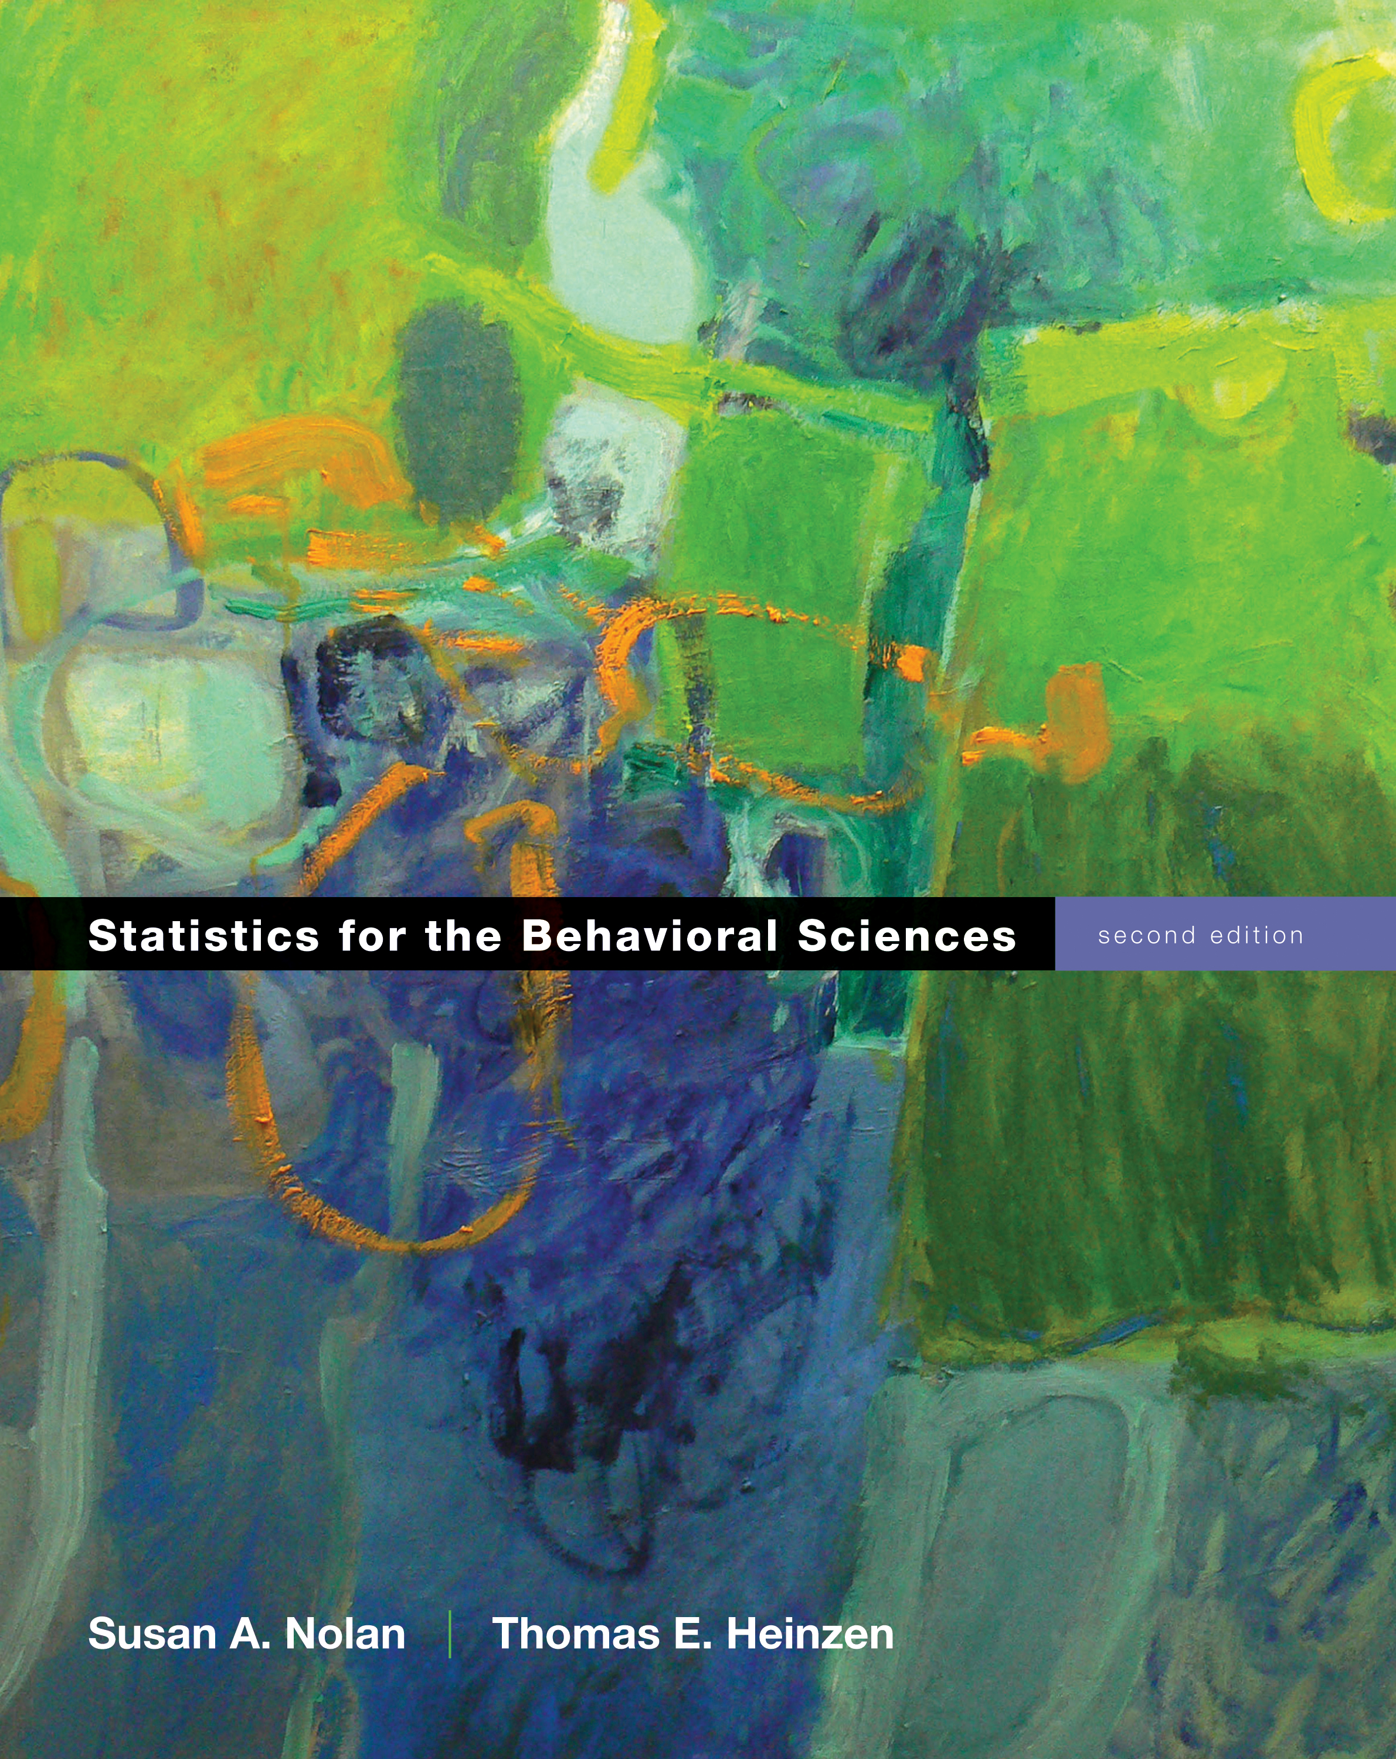
The Paired-Samples t Test
Chapter 10

Slide 2
Research Design Issues
So far, everything we’ve worked with has been one sample
One person = Z score
One sample with population standard deviation = Z test
One sample no population standard deviation = single t-test

Slide 3
Research Design Issues
So what if we want to study either two groups or the same group twice
Between subjects = when people are only in one group or another (can’t be both)
Repeated measures = when people take all the parts of the study

Slide 4
Research Design Issues
Between subjects design = independent t test (chapter 11)
Repeated measures design = dependent t test (chapter 10)

Slide 5
Research Design Issues
So what do you do when people take things multiple times?
Order effects = the order of the levels changes the dependent scores
Weight estimation study
Often also called fatigue effects
What to do?!

Slide 6
Research Design Issues
Counterbalancing
Randomly assigning the order of the levels, so that some people get part 1 first, and some people get part 2 first
Ensures that the order effects cancel each other out
So, now we might meet step 2!

Slide 7
Assumptions
Assumption | Solution
Normal distribution | N >=30
DV is scale | Nothing – do nonparametrics
Random selection (sampling) | Random assignment (to which counterbalance order! We can do this now!)

Slide 8
Paired-Samples t Test
Two sample means and a within-groups design
We have two scores for each person … how can we test that?
The major difference in the paired-samples t test is that we must create difference scores for every participant

Slide 9
Paired-Samples t Test
Distributions
Z = Distribution of scores
Z = distribution of means (for samples)
t = distribution of means (for samples with estimated standard deviation)
t = distribution of differences between means (for paired samples with estimated standard deviation)

Slide 10
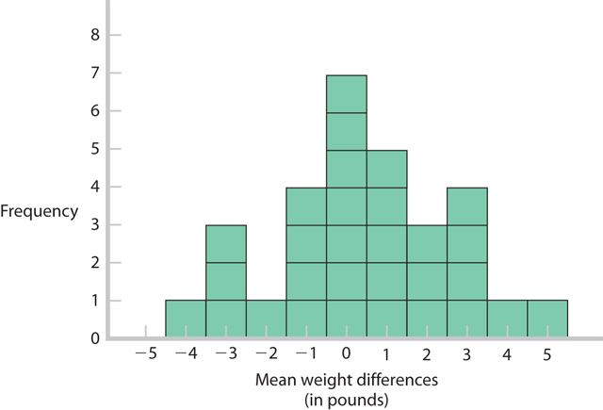
Distribution of Differences Between Means

Slide 11
Distribution of Differences Between Means
So what does that do for us?
Creates a comparison distribution (still talking about t here … remember the comparison distribution is the “population where the null is true”)
Where the difference is centered around zero, therefore um = 0.

Slide 12
Distribution of Differences Between Means
When you have one set of scores by creating a difference score …
You basically are doing a single sample t where um = 0.
Whew! Same steps.

Slide 13
Steps for Calculating Paired Sample t Tests
Step 1: Identify the populations (levels), distribution, and assumptions.
Step 2: State the null and research hypotheses.
Step 3: Determine the characteristics of the comparison distribution.
Step 4: Determine critical values, or cutoffs.
Step 5: Calculate the test statistic.
Step 6: Make a decision.

Slide 14
Step 1
Let’s work some examples: chapter 10 docx on blackboard.
List out the assumptions:
DV is scale?
Random selection or assignment?
Normal?

Slide 15
Step 2
List the sample, population, and hypotheses
Sample: difference scores for the two measurements
Population: those difference scores will be zero (um = 0)

Slide 16
Step 3
List the descriptive statistics
M difference:
SD difference:
SE difference:
N:
um = 0

Slide 17
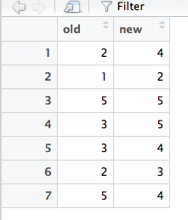
Calculating in R
You will have two sets of scores to deal with.
We can use these scores in wide format, so let’s enter them that way.
Excel file is online.

Slide 18
Calculating in R
We want to get a mean difference score first.
Important! Think about the hypothesis. If you pick a one-tailed test, the order of subtraction is important!

Slide 19
Calculating in R
Create a difference score to calculate the numbers you need:
difference = data$column – data$column

Slide 20
Calculating in R
Get the mean, sd, and se in the same way we did in the last chapter:
summary(difference)
sd(difference)
sd(difference) / sqrt(length(difference))

Slide 21
Step 4
Figure out the cut off score, t_{critical}
Less test:
qt(.05, df, lower.tail = T)
Greater test:
qt(.05, df, lower.tail = F)
Difference test:
qt(.05/2, df, lower.tail = T)
May also be .01 – remember to read the problem.

Slide 22
Step 5
Find t_{actual}
t.test(data$column,
data$column,
paired = T,
alternative = “less” OR “greater” OR “two.sided”,
conf.level = .95 OR .99)

Slide 23
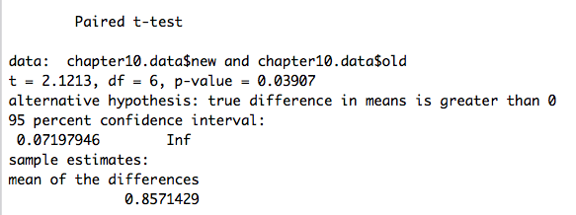
Step 5
Stop! Make sure your mean difference score, df, and hypothesis all match.

Slide 24
Step 6
Compare step 4 and 5 – is your score more extreme?
Reject the null
Compare step 4 and 5 – is your score closer to the middle?
Fail to reject the null

Slide 25
Confidence Interval
Lower = M_{difference} – t_{critical}*SE
Upper = M_{difference} + t_{critical}*SE
A quicker way!
Use t.test() with a TWO tailed test to get the two tailed confidence interval.
Or use the effect size coding R script!

Slide 26
Effect Size
Cohen’s d:
Note this S = s of the difference scores not s of either level.
Remember, SD = s.

Slide 27
Effect Size
Run all the effsize.R to get the right functions.
d.deptdiff(mdiff = .857, sddiff = 1.07, n = 7, a = .05, k = 2)
M = 0.86, SD = 1.07, SE = 0.40, 95%CI[-0.13 - 1.85]
t(6) = 2.12, p = 0.08, d = 0.80, 95%CI[-0.09 - 1.64]
- Remember that t values here are always two-tailed, t will match but not necessarily p.

